Slide 1
WEEK - 3
Sonam Rinjin Sherpa

Slide 2
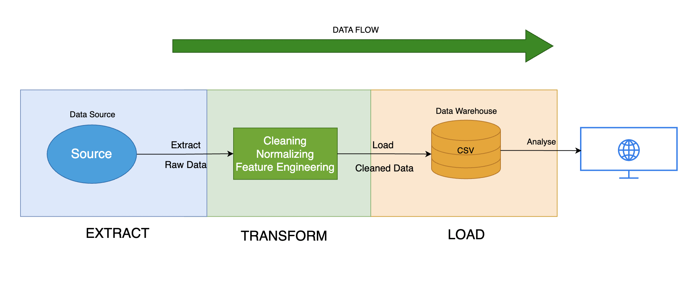
DATA PIPELINE
Notes:
The data will be retrieved from the relational database 'MSDS610' we created in the previous week.
The data will be then checked for missing values, duplicates, and outliers. The categorical features will be encoded.
I will also add some new features into the dataset such as income to education ratio, work hour category etc.
After the modifications, the new cleaned data will be added to the 'cleaned' schema.

Slide 3
Pipeline Type – Batch
I chose batch pipeline because
The dataset I have chosen (adult dataset) is a static dataset.
Batch pipeline makes it easier to transform and clean data more efficiently.
The dataset doesn't require real time processing and analysis.
A machine learning model is usually trained with a full dataset rather than real-time data.

Slide 4
DATA FORMAT - CSV
I have chosen CSV because -
It is a readable by human as it is just plain text.
It can be easily modified and manipulated.
The dataset I have chosen is a medium-sized dataset, and CSV fits perfectly.
Easier to process with Python

Slide 5
DATA QUALITY ISSUES
NAME | EFFECT | VALIDATION
Null Value | It can lead to biased results Might impact the process of down streaming | df.isull( ).sum( ) - Find sum of null values. Use imputation techniques or remove null values.
Duplicate Value | Inflate the sample size Hamper statistical analysis | duplicate_count = df.duplicated( ).sum( ) Drop the duplicate values.
Categorical Variables | Inconsistent Values Category Imbalance | One-Hot Encoding df = pd.get_dummies(df, columns=['gender', 'education'])

Slide 6
Data Drift
To tackle data drift, I can
Keep the reference of the initial distributions of important numerical features
Mean, Medain, Mode, Variance
Make it the baseline for comparision

Slide 7
Schema Change
To avoid schema change -
Log Mismatches
Make predefined schema as the template for the new datasets.
Discard unexpected data

Slide 8
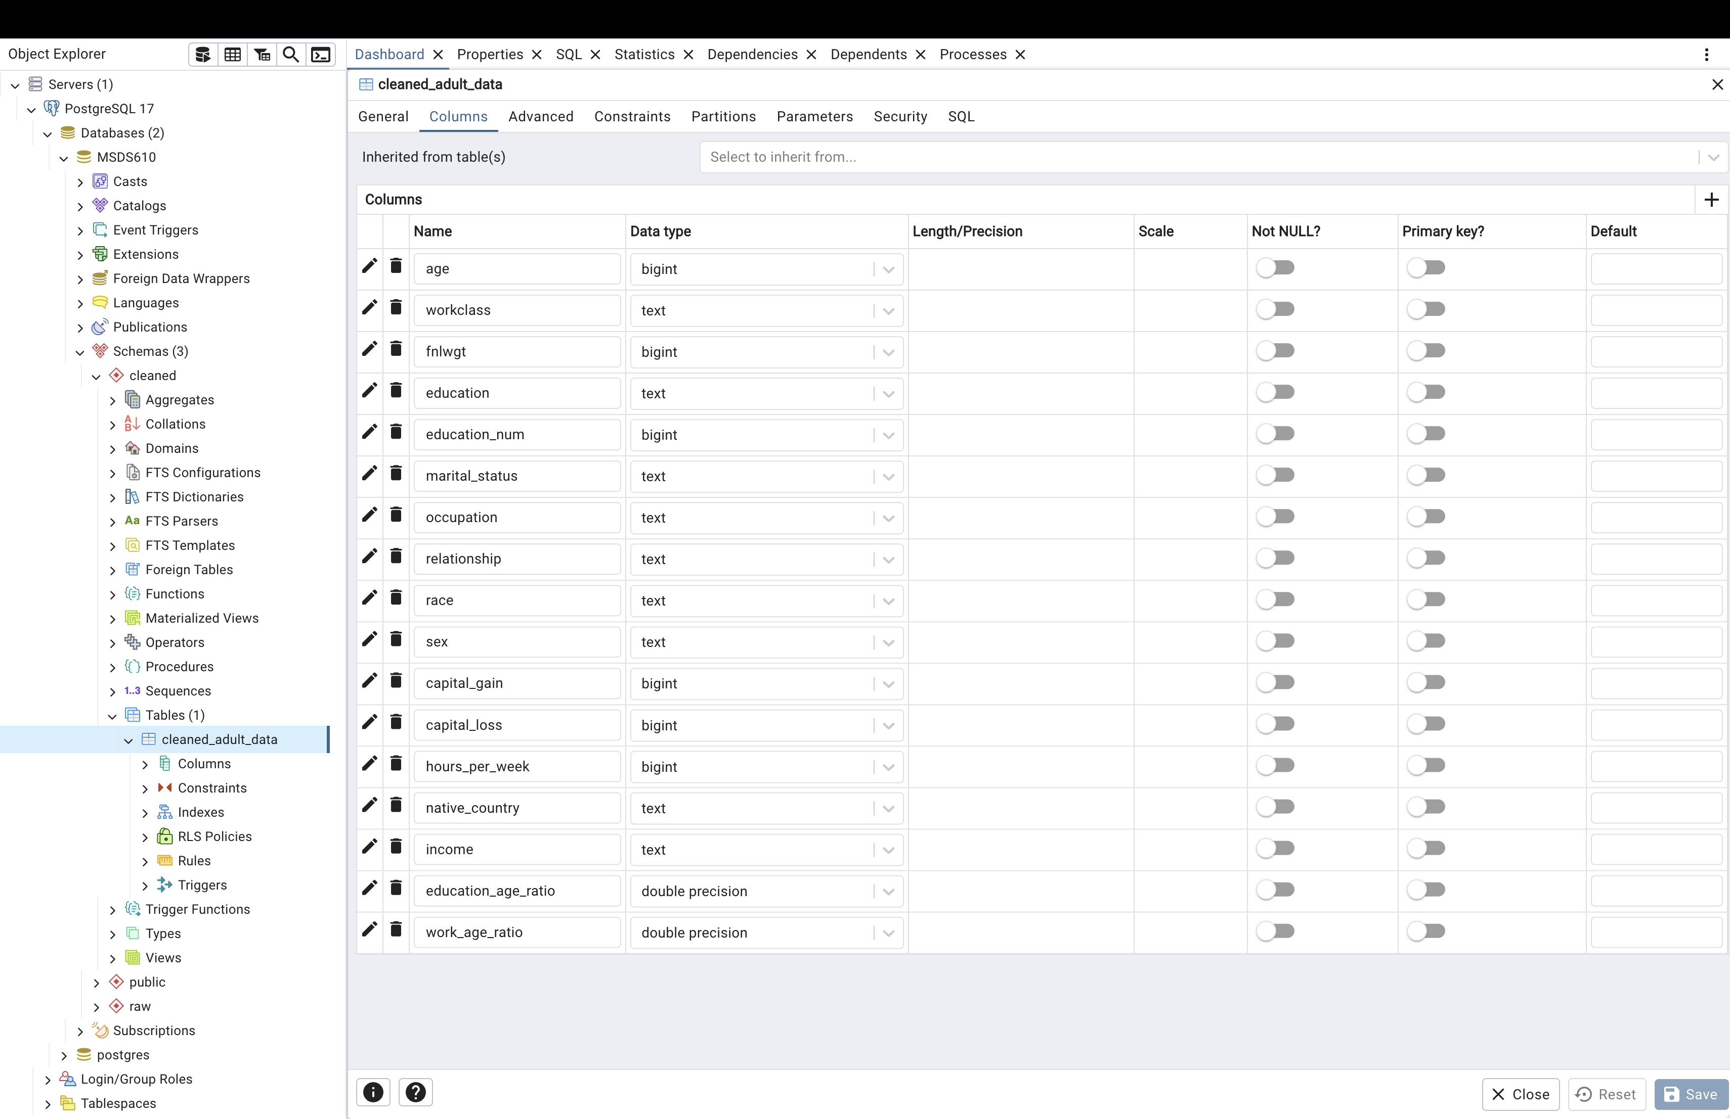
SCREENSHOT

Slide 9
THANK YOU

